Slide 1
DIGITAL LOGIC · PROJECT DEMONSTRATION
DESIGN AND SIMULATION OF AN EVEN PARITY GENERATOR USING XOR GATES
GROUP – 4
RESHMA – 2620030330
SUJAN – 2620030354
MOKSHITH – 2620030369
SAMANVITHA – 2620030276
ACHSAH – 2620030402
Notes:
Introduce the project as a four-input even parity generator. The presentation moves from the purpose of parity, through the XOR design and Logisim implementation, to verification with the complete truth table.

Slide 2



01 · WHY PARITY
PARITY ADDS ONE BIT TO MAKE ERRORS VISIBLE
Generate
Balance
Create one even parity bit for a digital data word.
Make the total number of 1s even during transmission or storage.
A parity bit gives a digital word a simple consistency check before it is transmitted or stored.
Project objective
Expose
Design the logic, implement it in Logisim, and verify all input combinations.
A changed bit can disturb the expected parity and become visible.
Notes:
Parity does not correct an error. It adds a predictable relationship to the data so that a single-bit change can be detected when the word is checked.

Slide 3


02 · LOGIC DESIGN
CASCADED XOR GATES GENERATE THE PARITY BIT
For inputs A, B, C, and D:
INPUTS A,B
XOR1
Why XOR works
XOR outputs 1 when its inputs contain an odd number of 1s. Cascading gates extends that behavior to multiple inputs.
XOR2
XOR3 → P
Even parity transmits A B C D P. For odd parity, invert P with a NOT gate.
Notes:
Walk the signal from left to right. XOR1 combines A and B, XOR2 adds C, and XOR3 adds D. The final output is the parity bit P. If the design must produce odd parity instead, place a NOT gate after the generated output.

Slide 4
03 · IMPLEMENTATION
LOGISIM TURNS THE BOOLEAN EXPRESSION INTO A WORKING CIRCUIT
Build the circuit in three short stages, then test the output by changing each input switch.
01
02
03
Place
Connect
Test
Four input pins, three 2-input XOR gates, and one output pin for P.
A and B feed XOR1; its output combines with C in XOR2.
XOR2 combines with D in XOR3. Observe P and toggle each input.
FOUR INPUTS
THREE XOR GATES
ONE OUTPUT
Notes:
In Logisim, place the components first so the structure is easy to inspect. Connect the gates in order, then use the switches to create test cases. The output should change whenever the number of active inputs changes from even to odd or from odd to even.

Slide 5
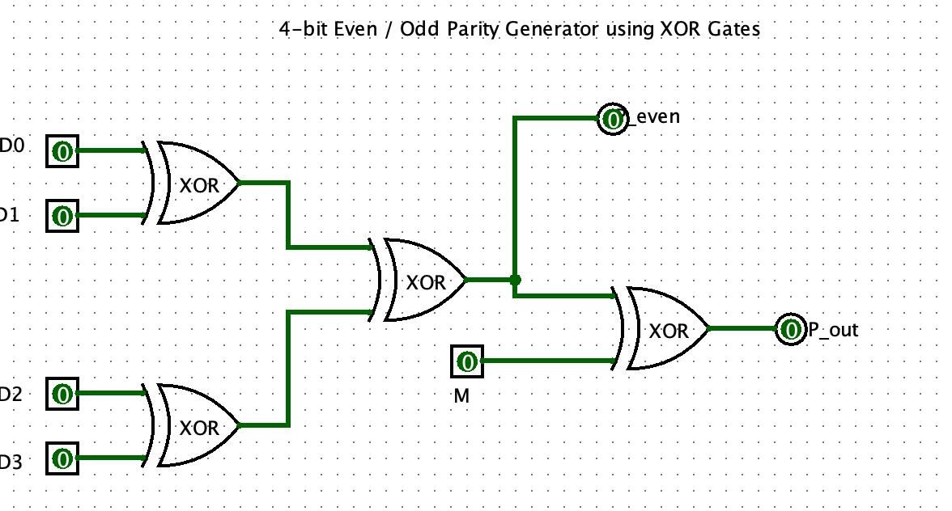
04 · VERIFICATION
THE TRUTH TABLE CONFIRMS EVERY INPUT COMBINATION
P = A ⊕ B ⊕ C ⊕ D. Rows with P = 1 produce a five-bit word with an even number of 1s.
A | B | C | D | P
0 | 0 | 0 | 0 | 0
0 | 0 | 0 | 1 | 1
0 | 0 | 1 | 0 | 1
0 | 0 | 1 | 1 | 0
0 | 1 | 0 | 0 | 1
0 | 1 | 0 | 1 | 0
0 | 1 | 1 | 0 | 0
0 | 1 | 1 | 1 | 1
A | B | C | D | P
1 | 0 | 0 | 0 | 1
1 | 0 | 0 | 1 | 0
1 | 0 | 1 | 0 | 0
1 | 0 | 1 | 1 | 1
1 | 1 | 0 | 0 | 0
1 | 1 | 0 | 1 | 1
1 | 1 | 1 | 0 | 1
1 | 1 | 1 | 1 | 0
Simulation evidence
Check representative switch settings against the matching truth-table rows. The highlighted P = 1 cases are the odd-input cases.
Notes:
The table contains all 16 possible combinations for four inputs. Highlight the rows where P is 1. In each of those rows, the original data contains an odd number of 1s, so adding P makes the five-bit transmitted word even.

Slide 6


05 · RESULT AND NEXT USE
THE CIRCUIT IS COMPACT, TESTABLE, AND REUSABLE
Applications
Next improvement
Error detection in digital communication, memory systems, data buses, and serial links.
Add an even-parity checker so the received word can be validated directly.
XOR gates provide a simple combinational solution for parity generation.
Scale it
Support wider data words and automate test cases in Logisim.
Key takeaway
The XOR network generates the correct even parity bit for every tested combination.
Notes:
Close by returning to the main result: the circuit is small, combinational, and easy to verify. The same XOR pattern can be extended to wider data words, paired with a checker, or tested automatically in Logisim.

